Slide 1

High Performance Computing
Research Paper Presentation:
Concurrency Optimal Implementation of BST

Slide 2
Contents
Pretext
Binary Search Tree
Why Optimality in BST ?
Partial External Sequential Tree (PEST)
Linearizability in Parallel Programming
Lazy Locking Synchronization
2. Abstract
3. Metric of Concurrency
4. Implementation Idea
What is a 'set' object?
5. Specification for PEBST
Few more Points on PEBST
Detail on Sequential Implementation
6. Concurrent Implementation - Optimistic Approach
Locks in Concurrent Implementation
Detail on different Locks used (6)
Detail on Concurrent Implementation
7. Correctness and Optimality
8. Comparision of their Algorithm
9. Performance Eval
10. Related Works and Discussions

Slide 3
Binary Search Tree(BST)
A binary search tree (BST) is a type of data structure used for efficient searching, insertion, and deletion operations. It is a binary tree where each node has at most two children, commonly referred to as the left and right child.
In a BST, the left child of a node contains a key that is smaller than the key of its parent node, and the right child contains a key that is greater than or equal to the key of its parent node. This property ensures that the nodes are ordered in a specific way, making it easy to search for a particular key.

Slide 4
Why Optimality in BST ?
Optimality is important for BSTs because the efficiency of the search, insertion, and deletion operations depends on the structure of the tree. In an optimal BST, the height of the tree is minimized, which leads to faster operations, as the number of comparisons required to find a particular key is proportional to the height of the tree.
If the BST is not optimal, it may have a large height, which can lead to slower operations. For example, if the BST is skewed, with all nodes in the tree branching in one direction, the height of the tree can be equal to the number of nodes, leading to inefficient performance. In such a case, the search, insertion, and deletion operations may take O(n) time, where n is the number of nodes in the tree.
To ensure the optimality of a BST, various techniques can be used, such as self-balancing BSTs like AVL trees and Red-Black trees.

Slide 5
Partial External Sequential Tree (PEST)
A partial external tree is a type of binary search tree in which some of the nodes are stored externally in a linked list.
The external nodes are used to reduce the height of the tree and improve search performance.
When a node is deleted from a partial external tree, it is replaced by an external node that contains the node's value.
The internal node is then used as a routing node to simplify future deletions.
Partial external trees are used in some concurrent binary search tree algorithms to simplify deletions and improve performance.
In a PEST, all internal nodes are stored in a binary tree structure, while all external nodes are stored sequentially in an array-like structure. This layout allows for efficient traversal and search operations, as the sequential storage of external nodes can be easily traversed using array indexing.

Slide 6
Linearizability in parallel programming
Linearizability is a correctness criterion in parallel and concurrent programming that ensures that operations on shared data structures appear to occur atomically and in a well-defined order.
In a linearizable system, each operation on a shared data structure can be treated as if it occurred instantaneously at some point between its invocation and its completion, and that point is called its linearization point. The result is that the system appears to be a single-threaded execution, where all operations occur in a global order that respects the order in which they were invoked. A linearization point refers to a point in a program's execution where memory writes become visible to other CPUs in the system
In other words, a linearizable system ensures that concurrent operations on shared data structures appear to occur sequentially in a way that is consistent with the order in which they were invoked by the various threads.

Slide 7
Lazy Locking Synchronization
Lazy locking synchronization is a synchronization technique used in concurrent programming to delay the acquisition of locks until they are actually needed. This technique is used to reduce contention and improve performance in situations where locks are frequently acquired and released. In lazy locking synchronization, locks are acquired only when necessary, and are released as soon as possible to minimize the time that other threads are blocked.

Slide 8
Abstract
The paper presents the first concurrency-optimal implementation of a binary search tree (BST).
The implementation, based on a standard sequential implementation of a partially-external tree, ensures that every schedule, i.e., interleaving of steps of the sequential code, is accepted unless linearizability is violated.
To ensure Linearizability, they used read-write locking protocol that protects tree edges in addition to its nodes.
To ensure concurrent operations do not violate correctness of the implemented high level data type, data accesses are “protected” with synchronization primitives, e.g., acquisitions and releases of locks.
Hence "Making progress in parallel" means allowing concurrent execution of pieces of locally sequential fragments of code.
The more synchronization they use to protect “critical” pieces of the sequential code, the less schedules, they accept. So like to use little sync to ensure linearizability.

Slide 9
Metric for Concurrency
Amount of concurrency: Metric used to measure how concurrent 2 diff implementations of same data structure. Defined via set of accepted(correct) schedules given in another research paper. A correct schedule, intuitively, requires the sequence of sequential steps locally observed by every given process to be consistent with some execution of the sequential algorithm.
Combined with the standard correctness criterion of linearizability, the concurrency properties of two correct data structure implementations can be compared on the same level: implementation A is “more concurrent” than implementation B if the set of schedules accepted by A is a strict superset of the set of schedules accepted by B. Thus, a concurrency optimal implementation accepts all correct schedules.

Slide 10
Implementation Idea
Their implementation: Linearizable Concurrent BST-based set implementation + Lazy locking approach. Only read operations don't need to acquire locks as using Lazy Locking.
Unlike most implementations of concurrent trees, the algorithm uses multiple locks per node: one lock for the state of the node, and one lock for each of its descendants.
Also used fine grained conditional read write lock: To ensure that only conflicting operations can delay each other. Locking of nodes and edges allows us to ensure that an implementation rejects a schedule only if it violates linearizability.
Note: Optimal concurrency does not necessarily imply performance nor maximum progress.

Slide 11

Implementation

Slide 12
What is "set" object?
A set object stores a set of integer values, initially empty, and makes available operations insert(v), remove(v), contains(v).
The set object contains the values from all nodes of the internal binary search tree. These values collectively constitute the implemented set.
And an external binary search tree, where the set is represented by the values in the leaves.

Slide 13
Specification for partially-external binary search tree
Specification of PEBST:
Stores set of integer values. Initially set i.e BST is empty
Operations
insert(elem)
Returns true: if and only if elem is absent. End result elem gets added to BST
remove(elem)
Returns true: if and only if elem is present. End result elem gets deleted from BST
contains(elem)
Returns true: if and only if elem is present.
Value property:
The order is carried by a value property: the value of each node is strictly greater than the values in its left subtree and strictly smaller than the values in its right subtree.

Slide 14
Few more Points on PEBST
PEBST = Internal BST(routing nodes) + External BST(values in leaves)
A partially-external tree supports two types of nodes: routing and data. The internal nodes are used for “routing” from the root to the leaves.
To bound the number of routing vertices by the number of data nodes, the tree should satisfy an additional condition that all routing nodes must have exactly two children.
Note: Routing nodes are not used to store values directly, but instead are used for navigation to other nodes that contain the values. By changing the state of the routing node to data, the algorithm effectively adds 'v' to the set at the appropriate position in the data structure.

Slide 15
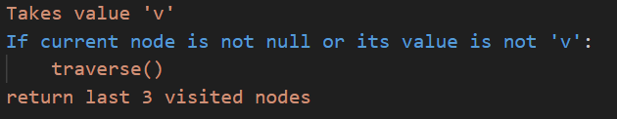
Detail on Sequential Implementation
Traversal:
Contains

Slide 16
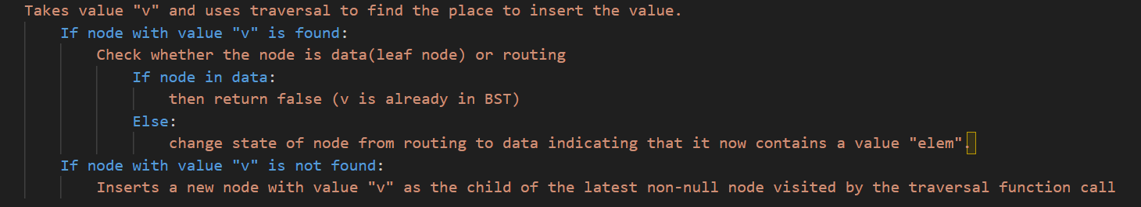
Detail on Sequential Implementation
Insert

Slide 17
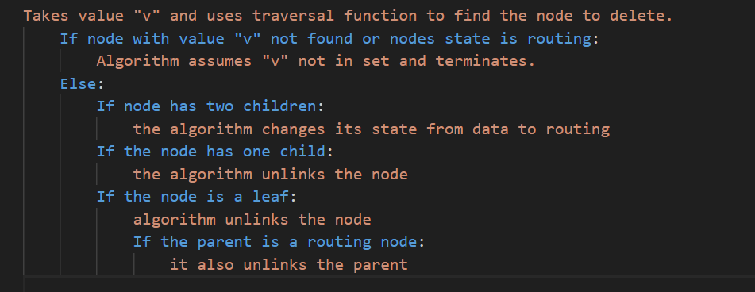
Detail on Sequential Implementation
Delete

Slide 18
Concurrent Implementation - Optimistic Approach
Note: Their implementation if traversed inorder we get descending order of elements
Each node is represented as a union of records val, the value in the node of arbitrary comparable type, slock, the lock that guards the state, llock and rlock, the locks that guard the pointers to left and right children, correspondingly, and deleted, the flag of logical deletion.
Traversal
Wait-Free: Locations to be modified are locked and then the reads performed during the traversal are validated. If validation fails, the operation is restarted.
When the algorithm reads the field it stores it in the “cache” and further accesses return the “cached” value instead of reading the same field twice.
Deletion
Deletion of the node happens in two stages. At first, the delete operation logically removes a node from the tree by setting the boolean flag to deleted.
Secondly, the delete operation updates the links to physically remove the node.

Slide 19
Locks in Concurrent Implementation
Implemented read-write lock for each field of node simply as one lock variable.
The smallest bit of lock indicates whether the write lock is taken or not, the rest part of the variable indicates the number of readers that have taken a lock
In other words, lock is zero if the lock is not taken, lock is one if the write lock is taken, otherwise, lock divided by two represents the number of times the read lock is taken. The locking and unlocking are done using the atomic compare-and-set primitive.
Along, with standard tryWriteLock, tryReadLock, unlockWrite and unlockRead we provide additional six functions on a node: tryLockLeftEdge(Ref|Val)(exp), lockRightEdge(Ref|Val)(exp) and try(Read|Write)LockState(exp)
| indicates as either we choose the first option or the second option.

Slide 20
Detail on different Locks used (6)
tryLock(Left|Right)EdgeRef(exp): Ensures that the lock is taken only if the field (left or right) guarded by that lock is equal to exp, i.e., the child node has not changed, and the current node is not deleted, i.e., its deleted mark is not set
tryLock(Left|Right)EdgeVal(exp): Ensures that the lock is taken only if the value of the node in the field (left or right) guarded by that lock is equal to exp, i.e., the node could have changed but the value inside did not, and the current node is not deleted, i.e., its deletion mark is not set.
try(Read|Write)LockState(exp): Ensures that the lock is taken only if the value of the state is equal to exp and the node is not deleted, i.e., its deletion mark is not set
These six functions are implemented in the same manner: the function reads necessary fields and a lock variable, checks the conditions, if successful it takes a corresponding lock, then checks the conditions again, if unsuccessful it releases the lock.

Slide 21
Detail on Concurrent Implementation
Traversal Function == Traversal Function (sequential implementation)
Takes value "v" traverses down the tree respecting value property as long as current node is not null or its value is not "v" and returns last 3 visited nodes.
Contains
Checks if a particular node is deleted or not:
If deleted return false
Takes value "elem", checks last node visited by the traversal and returns whether it is null.
Insert and Delete follow from Sequential Implementation but with read write conditional lock.

Slide 22
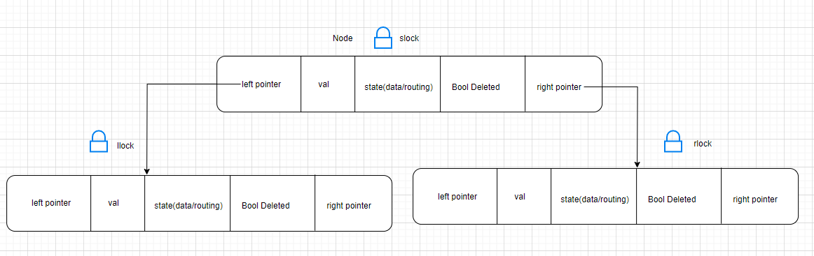
Node Structure

Slide 23
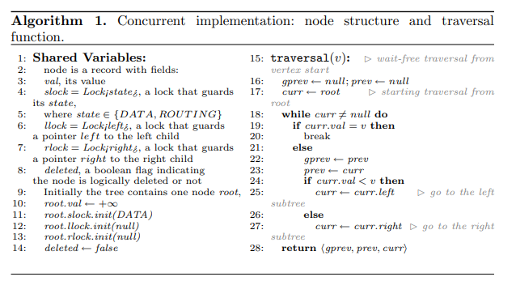

Slide 24
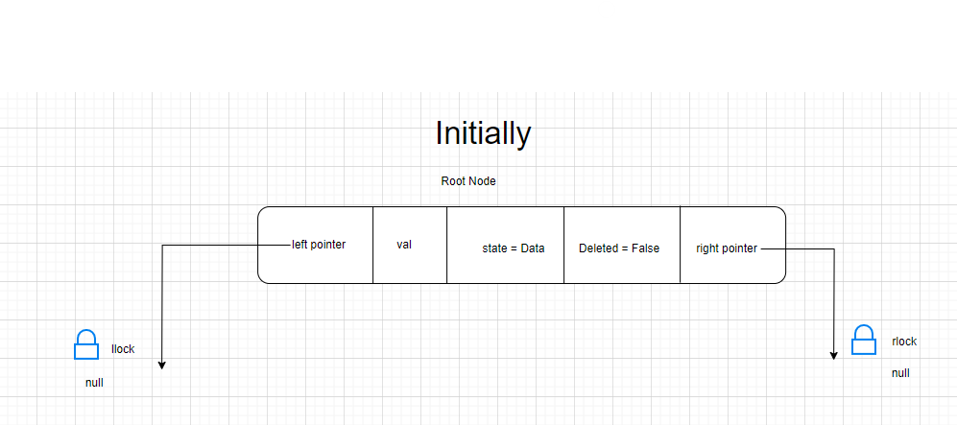
Initially

Slide 25
Traversal
In the given pseudocode, gprev and prev are variables that store the grandparent and parent nodes of the current node being traversed, respectively. gprev is updated to prev before prev is updated to curr in each iteration of the loop. This is done to keep track of the grandparent of the current node, which will be the parent of the next node to be traversed. The purpose of storing gprev and prev is to return them along with the current node when the node with value v is found in the tree
Also note traversal is lock free
Also note slock is the variable name in the node and not a lock(shown in illustration) which contains the state of the node

Slide 26
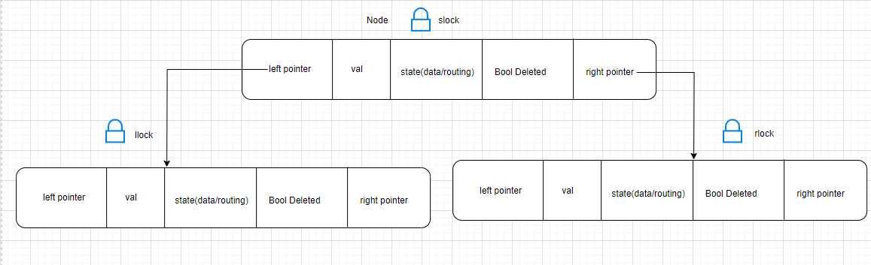
Traversal

Slide 27
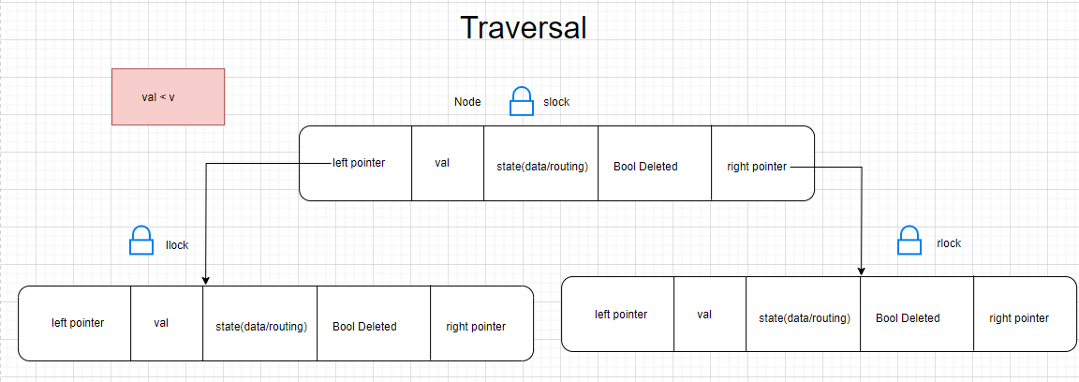

Slide 28
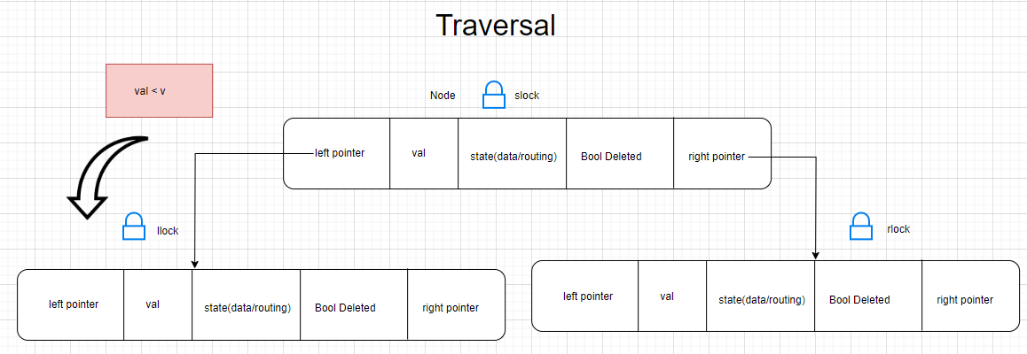

Slide 29
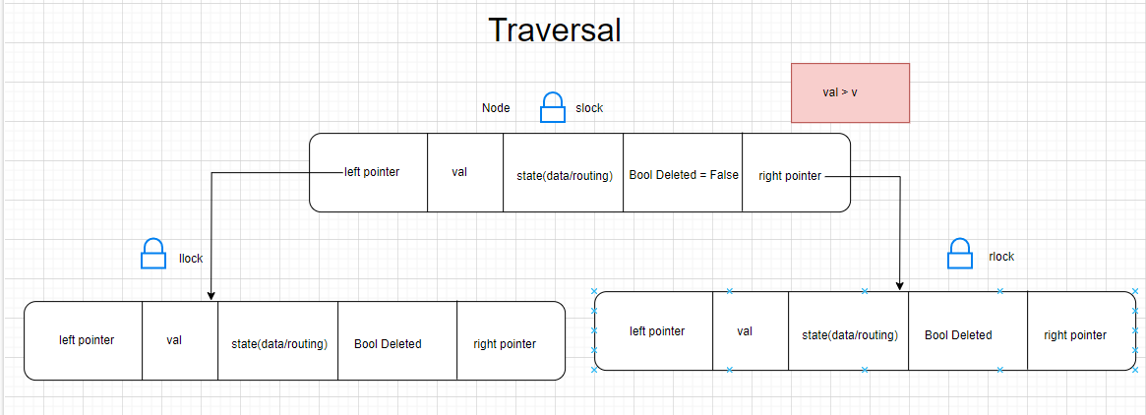

Slide 30
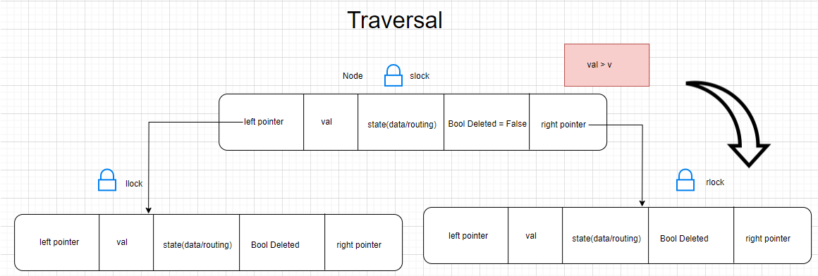

Slide 31
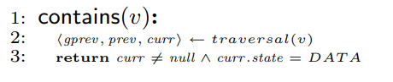
Contains

Slide 32
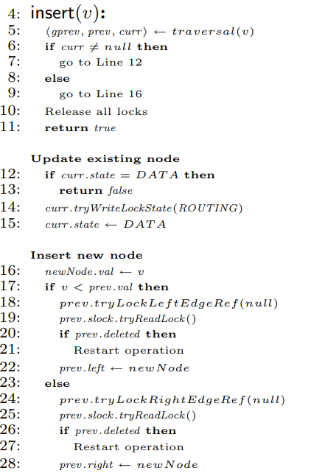
Insert

Slide 33
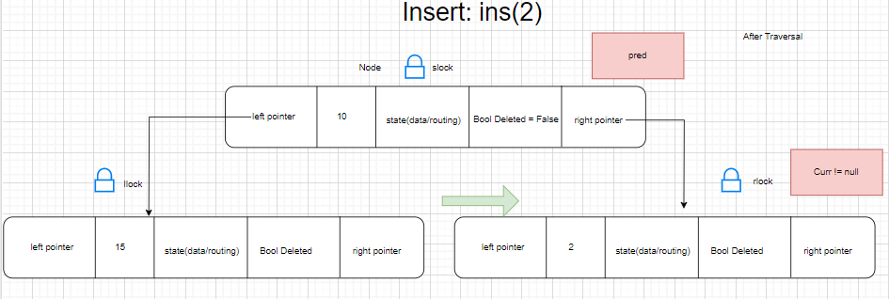
Insert (if already element present)

Slide 34
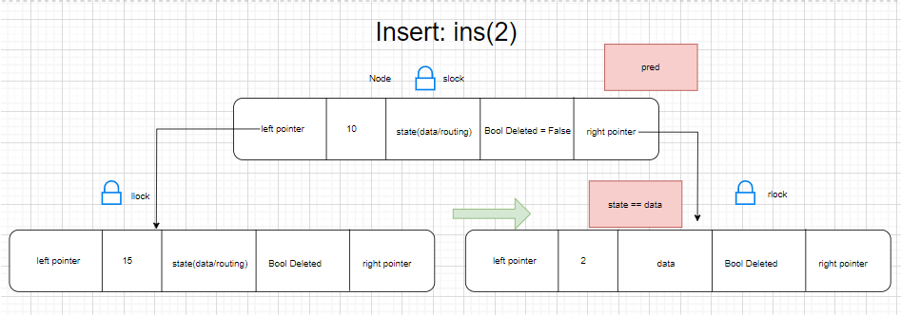
Insert (if already element present): Return false

Slide 35
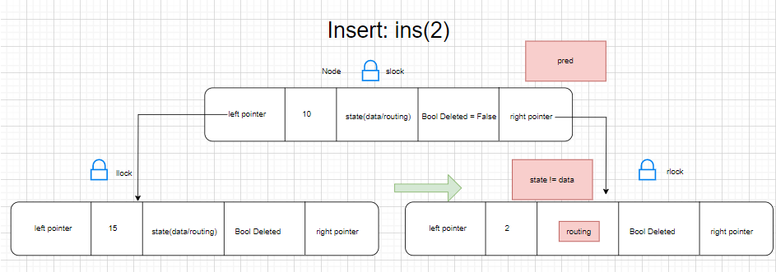

Insert (if already element present): if state is routing

Slide 36
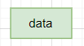
Insert (if already element present): change state to data

Slide 37
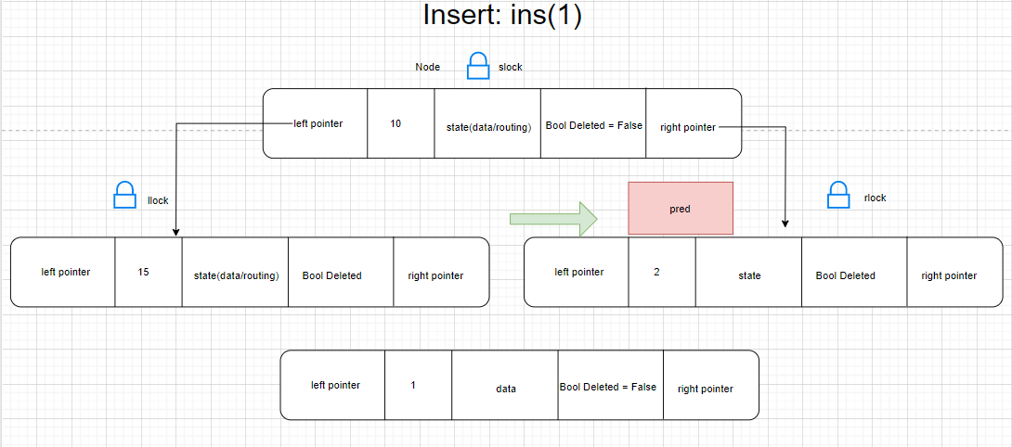

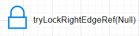
Insert (if need to insert new node):

Slide 38
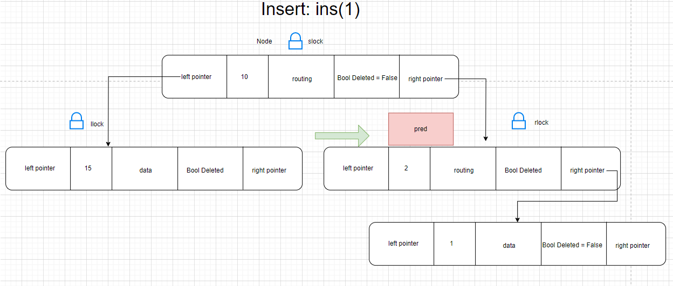
Insert (if need to insert new node):

Slide 39
Insert (if need to insert new node):​
RESTART OPERATION
If predecessor deleted by another thread before inserting restart the operation
DELEATED

Slide 40
Deletion
For deletion:
Current should not be equal to null (because we cannot delete a node which is not present)
Current State should be equal to "data"
Types of Deletion:
Delete node with 2 children
Delete node with 1 child
Delete leaf node with data present
Delete leaf node with routing parent

Slide 41
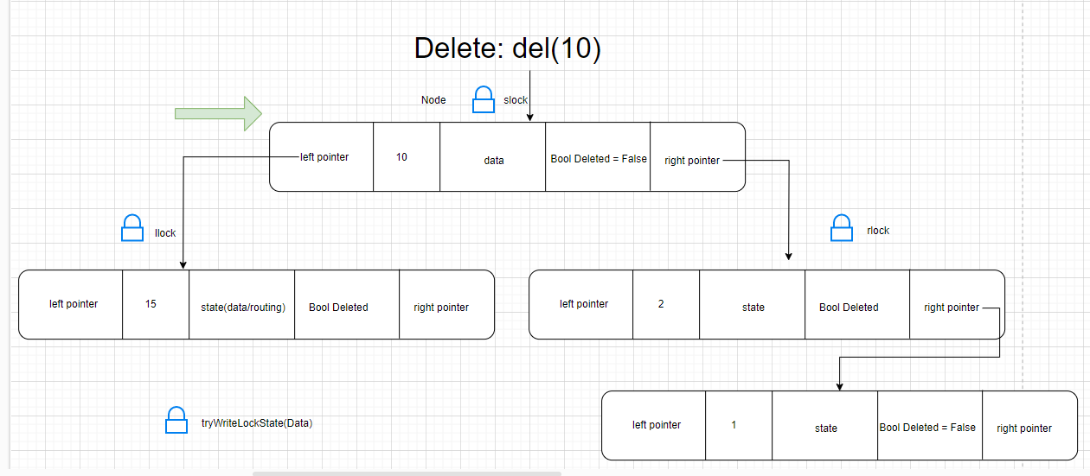
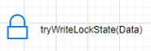
Delete node with 2 children

Slide 42
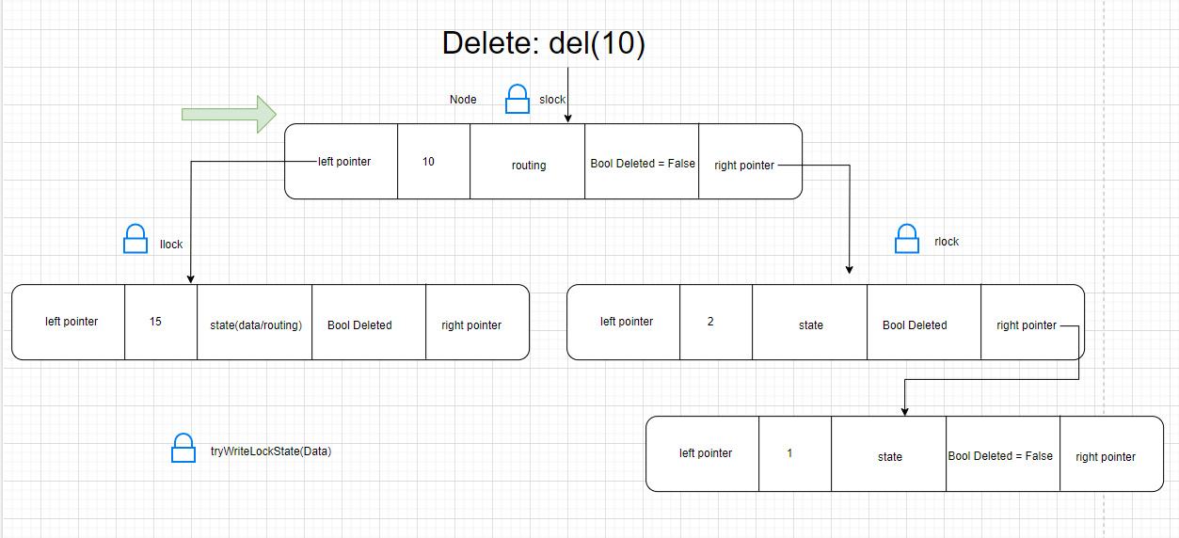
Delete node with 2 children

Slide 43
Need to have algo and explain next slide

Slide 44



Delete node with 1 child
Pred
Curr

Slide 45
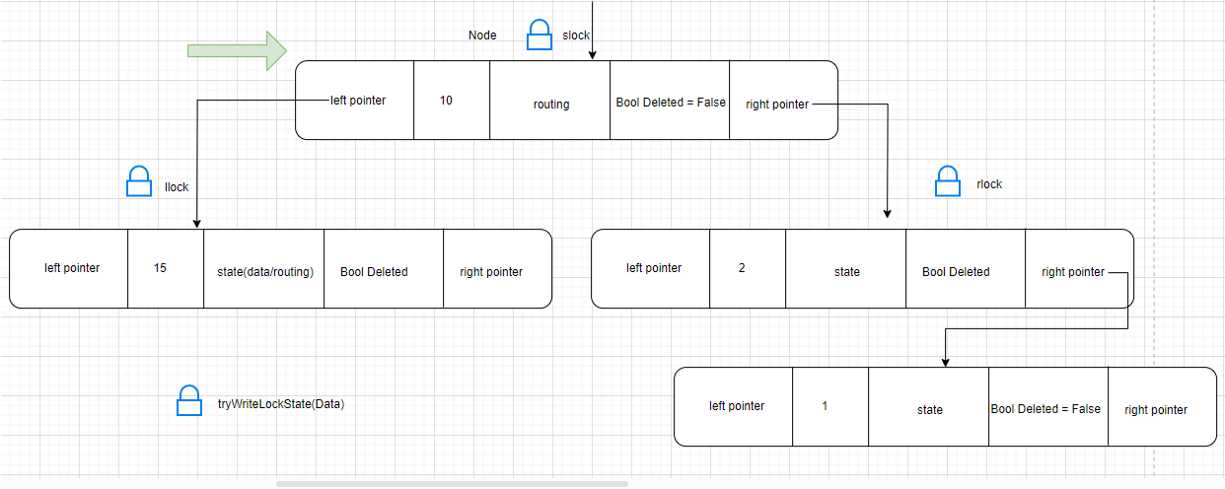
Delete Leaf with Data Present
Pred
Current
NULL

Slide 46
Delete Leaf with Routing Parent
GrandPrev
Prev
NULL
Curr

Slide 47
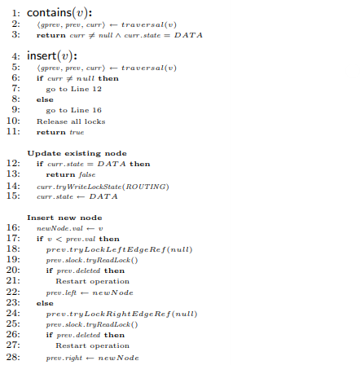
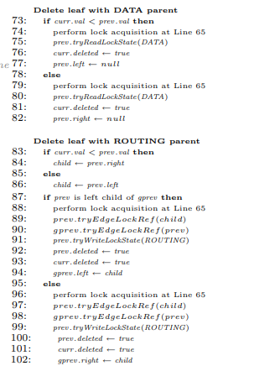
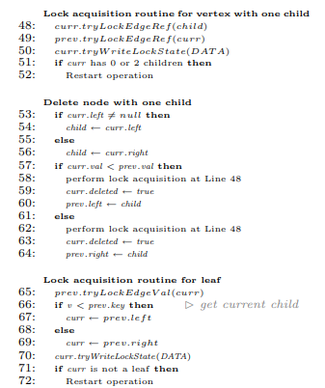
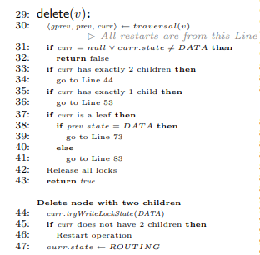

Slide 48
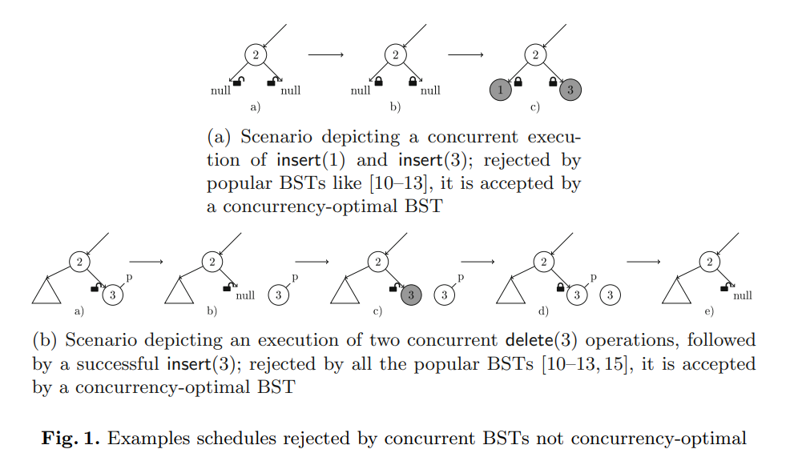
Correctness and Optimality
They show first that this is indeed the case with their algorithm: all the schedules it accepts are correct.
Theorem 1 (Correctness). The schedule corresponding to any execution of our BST implementation is observably correct.
Theorem 2 (Optimality). Our BST implementation is concurrency-optimal
They show that for each observably correct schedule there exists a matching execution of our implementation

Slide 49
Comparision of their Algorithm
They compare their algorithm, denoted as Concurrency Optimal or CO, against four other implementations of concurrent BST. They are:
(1) the lock-based Concurrency Friendly (or CF) tree by Crain et al.
(2) the lock-based Logical Ordering (or LO) AVL-tree by Drachsler et al.
(3) the lock-based BCCO tree by Bronson et al.
(4) the lock-free EFRB tree by Ellen et al. [13]. All these implementations are written in Java
To compare the performance they considered the following parameters:
(i) Workloads. Each workload distribution is characterized by the percent x% of update operations. This means that the tree will be requested to make 100 − x% of contains calls, x/2% of insert calls and x/2% of delete calls. They considered three different workload distributions: 0%, 20% and 100%.
(ii) Tree size. On the above workloads, the tree size depends on the size of the key space (the size is approximately half of the range). They considered three different key ranges: 215, 219 and 221. To ensure consistent results, rather than starting with an empty tree, they pre-populated the tree before execution.
(iii) Degree of contention. This depends on the number of hardware threads,
They average through 25 runs. Each run is carried out for 10 seconds

Slide 50
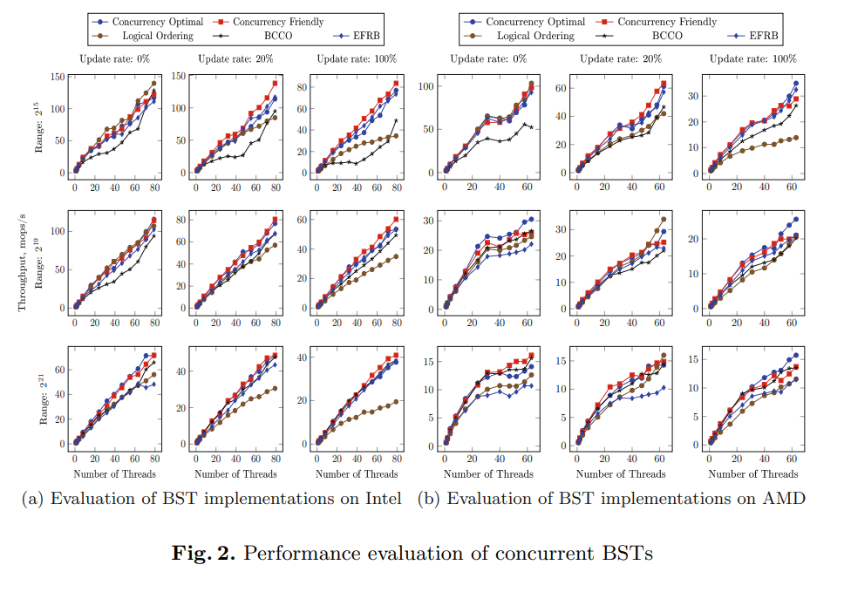
Performance Eval
With the increase of the size the performance of their algorithm becomes better relatively to CF-tree​
BCCO-tree was much worse on 2^15 and became similar to CO-tree on 2^21​
Algorithm works well regardless of the size.​
As the percentage of contains operations increases, the difference between their algorithm and CFtree becomes smaller and in most workloads, they perform better than other BSTs.

Slide 51

Related Work and Discussion
Measuring Concurrency:
Concurrency measurement has been proposed to compare concurrent data structures to their sequential counterparts.
Previous applications of this metric include a concurrency-optimal linked list and comparing synchronization techniques for concurrent search data structures.

Slide 52
Related Work and Discussion
Concurrent BSTs:
Various techniques have been proposed for implementing concurrent BSTs, such as transactional memory, optimistic synchronization, and speculation-friendly approaches.
Red-black trees optimized for hardware transactional memory and contention-friendly trees have also been studied.
The lock-free tree proposal and efficient lock-free binary search tree implementations have been proposed but not implemented in Java.
Despite these efforts, the concept of a concurrency-optimal BST has not been addressed until this study.

Slide 53
Related Work and Discussion
Search for Concurrency-Optimal Data Structures:
This study focuses on minimizing synchronization in BST implementations and identifies a highly concurrent and efficient implementation.
The implementation has been formally proven correct and established as concurrency-optimal.
The findings suggest a relationship between concurrency optimality and efficiency.
The hope is that this work will inspire the design of other concurrency-optimal data structures that currently lack efficient implementations.

Slide 54

Team Members:
Muvvala N V Sai Gurudeep SE20UARI103
Sreevalli Yelisetti SE20UARI148
Shashi Kanth Koppala SE20UARI140
Rama Sai Pavan Kotipalli SE20UARI123
Sudhira Chegu SE20UARI150

